Slide 1

Session 7
Linear Programming – Transportation
Big Data and Analytics
Topic 7: Model Evaluation
We will wait for 5 mins for everyone to join

Slide 2

Recap
Linear Programming – Transportation
What we discussed last week?

Slide 3
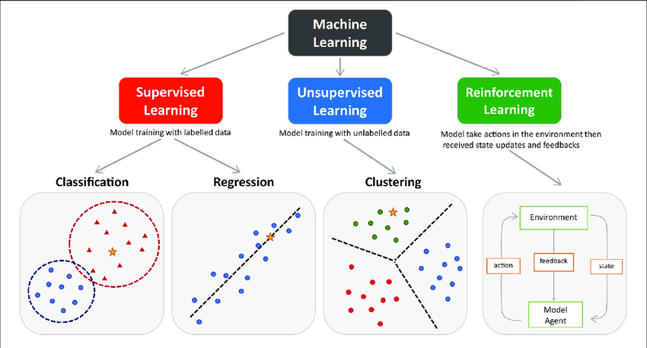
Recap: Supervised and Unsupervised Machine Learning
Supervised machine learning is generally used to classify data or make predictions, whereas unsupervised learning is generally used to understand relationships within datasets.
Supervised machine learning is much more resource-intensive because of the need for labelled data.
Classification: Categorising data into predefined classes
Regression: Predicting continuous values
Clustering: Grouping similar data points
Reinforcement Learning: Learning by interacting with an environment
Notes:
Image source:https://www.researchgate.net/publication/354960266_Machine_Learning_Techniques_for_Personalised_Medicine_Approaches_in_Immune-Mediated_Chronic_Inflammatory_Diseases_Applications_and_Challenges

Slide 4
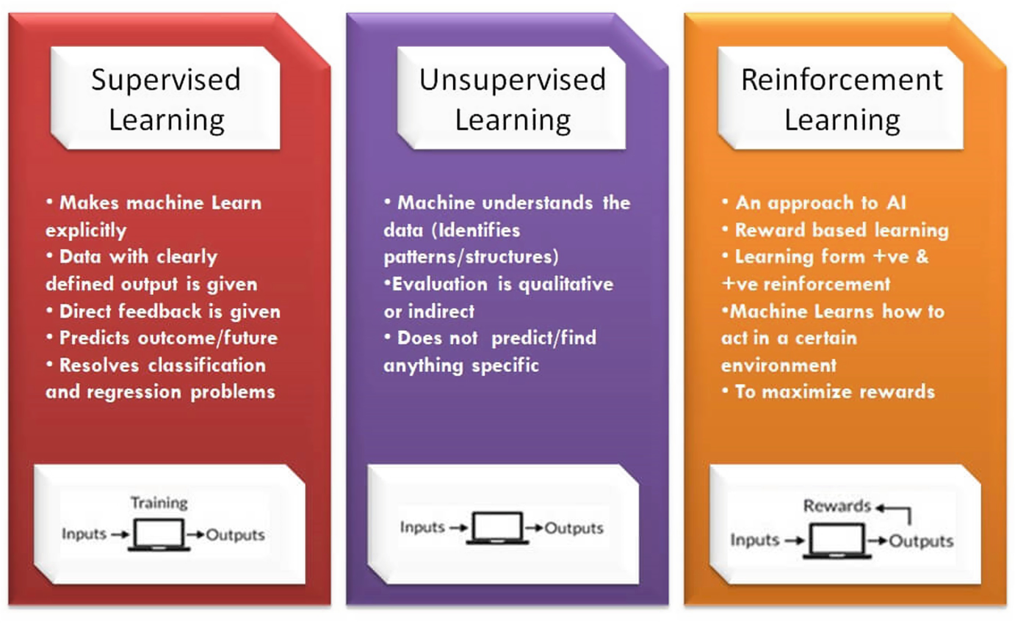
Recap: Supervised and Unsupervised Machine Learning
Source: Analytics Yogi

Slide 5
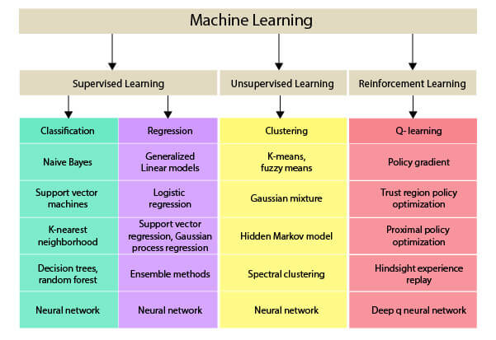
Recap: Supervised and Unsupervised Machine Learning
Some popular machine learning methods:
Source: NimbleBox.ai

Slide 6
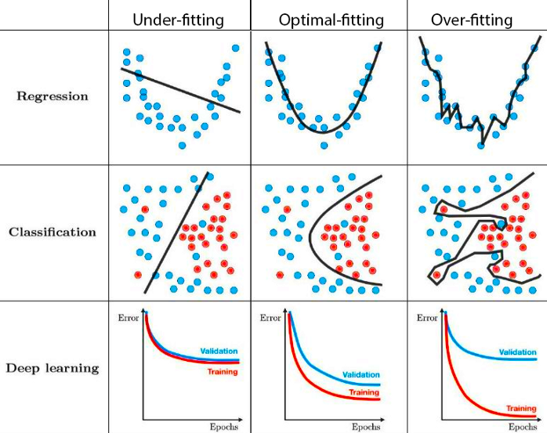
Recap: Overfitting and Underfitting
Underfitting – model is too simple, knows too little
Overfitting – model is too complex, learner memorizes too much
Good fit – just right, generalizes well, learner understands the data
Resources:
https://www.youtube.com/watch?v=jnAeZ8j0Ur0 &t=93s
https://www.ibm.com/think/topics/overfittingvs-underfitting

Slide 7
Evaluation
Importance of evaluation in machine learning
Assessing Model Performance: Evaluation methods provide quantitative measures to assess how well a model is performing. Metrics like accuracy, precision, recall, and F1-score for classification, or mean squared error for regression, give a clear picture of the model's effectiveness.
Overfitting and Underfitting Detection: Through evaluation, you can identify if your model is overfitting (performing well on training data but poorly on unseen data) or underfitting (performing poorly even on training data). This helps in tweaking the model or the training process to achieve a better balance.
Model Comparison and Selection: Evaluation metrics allow you to compare different models or algorithms and select the one that performs the best for a specific task. This comparison can be based on accuracy, speed, resource consumption, and other relevant metrics.
Hyperparameter Tuning: Evaluation plays a critical role in hyperparameter tuning. By assessing the model's performance with different hyperparameter values, you can find the best combination that yields the highest performance.

Slide 8
Evaluation
Importance of evaluation in machine learning
Ensuring Generalisation: A well-evaluated model is more likely to generalise well to new, unseen data, which is essential for real-world applications. This is particularly important in critical fields such as healthcare, finance, or autonomous driving.
Bias and Fairness Assessment: Evaluation methods can help identify biases in machine learning models. Ensuring that a model is fair and unbiased is crucial, especially when it affects people's lives or significant decisions.
Model Improvement: Continuous evaluation allows for iterative improvement of models. By understanding where a model fails or struggles, developers and data scientists can make targeted improvements.
Building Trust and Reliability: In many applications, stakeholders need to trust the model's predictions. Rigorous evaluation helps build confidence that the model will perform reliably in real-world conditions.
Regulatory Compliance: In certain industries, models must meet specific performance criteria before deployment. Evaluation ensures compliance with these regulatory standards.
Cost and Resource Management: By evaluating models effectively, organizations can avoid deploying inefficient or inaccurate models, which can be costly in terms of resources and potential risks.

Slide 9
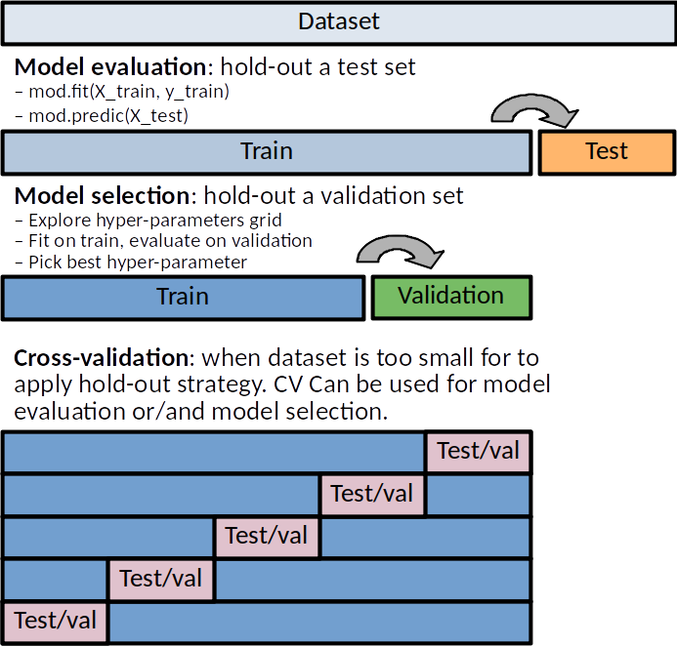
Evaluation
Train, Validate, Test
Training Set: Model learns patterns
Test Set: Model is evaluated on unseen data
Optionally: Validation set for tuning
Think of it as a practice test before your final exam
You might ask – why do we need a validation set?
To prevent overfitting – if your model does great on training data but poorly on validation data, may be its just memorizing as it is
To fine-tune the model
To decide when to stop training
Notes:
Picture Source:https://duchesnay.github.io/pystatsml/auto_gallery/ml_resampling.html

Slide 10
Evaluation
Evaluation Metrics for Classification
Accuracy, Precision, Recall, F1-Score
Confusion Matrix
ROC Curve and AUC (Area Under the Curve)
Precision-Recall Curve
Classification: Categorising data into predefined classes
Regression: Predicting continuous values
Clustering: Grouping similar data points
Reinforcement Learning: Learning by interacting with an environment

Slide 11
Evaluation
Evaluation Metrics for Regression
Mean Absolute Error (MAE)
Mean Squared Error (MSE)
Root Mean Squared Error (RMSE)
R-Squared and Adjusted R-Squared
Classification: Categorising data into predefined classes
Regression: Predicting continuous values
Clustering: Grouping similar data points
Reinforcement Learning: Learning by interacting with an environment

Slide 12
Evaluation
Evaluation Metrics for Clustering
Silhouette Coefficient
Davies-Bouldin Index
Calinski-Harabasz Index
Classification: Categorising data into predefined classes
Regression: Predicting continuous values
Clustering: Grouping similar data points
Reinforcement Learning: Learning by interacting with an environment

Slide 13
Evaluation
Evaluation Metrics for Reinforcement Learning
Cumulative Reward (Return)
Average Reward
Success Rate
Episode Length
Learning Curves
Value Function Estimation Accuracy
Sample Efficiency
Robustness and Generalization
Entropy of Policy
Behavioural Diversity
Benchmark Environments
Safety and Constraint Satisfaction
Resource Utilization
Classification: Categorising data into predefined classes
Regression: Predicting continuous values
Clustering: Grouping similar data points
Reinforcement Learning: Learning by interacting with an environment

Slide 14
Evaluation: Evaluation Metrics for Classification
True Positive (TP): The number of correct positive predictions.
(Type I error) False Positive (FP): The number of incorrect positive predictions.
True Negative (TN): The number of correct negative predictions.
(Type II error) False Negative (FN): The number of incorrect negative predictions.
Notes:
FP: A patient undergoes a screening test for cancer. The test comes back positive, indicating that the patient has cancer. However, upon further investigation (like a biopsy), it's found that the patient does not have cancer.
FN: A patient undergoes a screening test for cancer. The test comes back negative, indicating that the patient doesn't have cancer. However, in reality, the patient does have cancer, which goes undiagnosed.
Security Systems:
Airport Security: Failing to detect a weapon or prohibited item (FN) can have catastrophic consequences.
Cybersecurity: Not detecting a malware or breach can lead to extensive data loss or unauthorized data access.
Quality Control in Manufacturing:
Food Industry: Missing a contaminant in food products can lead to widespread illness.
Automobile Industry: Not catching a defect in a car part can lead to malfunctions, accidents, and recalls.
Natural Disaster Predictions:
Tsunami or Earthquake Early Warning Systems: Failing to predict a significant seismic event can lead to unprepared populations facing disasters.

Slide 15
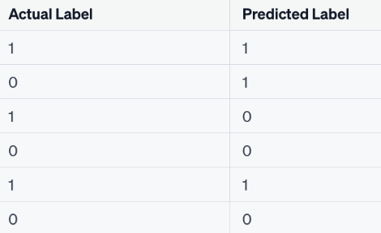
Evaluation: Evaluation Metrics for Classification
True Positive (TP): The number of correct positive predictions.
False Positive (FP): The number of incorrect positive predictions (Type I error).
True Negative (TN): The number of correct negative predictions.
False Negative (FN): The number of incorrect negative predictions (Type II error).
Example: Now, consider a hypothetical small dataset where we're trying to predict if an email is:
spam (1) or not spam (0)
How Many:
TP? →Emails that are actually spam and are correctly predicted as spam.
FP? →Emails that are not spam but are incorrectly predicted as spam.
TN? →Emails that are not spam and are correctly predicted as not spam.
FN? →Emails that are spam but are incorrectly predicted as not spam.
Notes:
TP (True Positives): Emails that are actually spam and are correctly predicted as spam.
Count: 2 (The ones with Actual Label = 1 and Predicted Label = 1)
FP (False Positives): Emails that are not spam but are incorrectly predicted as spam.
Count: 1 (The one with Actual Label = 0 and Predicted Label = 1)
TN (True Negatives): Emails that are not spam and are correctly predicted as not spam.
Count: 2 (The ones with Actual Label = 0 and Predicted Label = 0)
FN (False Negatives): Emails that are spam but are incorrectly predicted as not spam.
Count: 1 (The one with Actual Label = 1 and Predicted Label = 0)

Slide 16
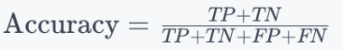
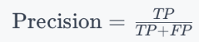
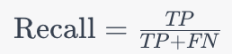
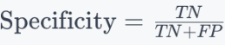
Evaluation: Evaluation Metrics for Classification
True Positive (TP): The number of correct positive predictions.
False Positive (FP): The number of incorrect positive predictions (Type I error).
True Negative (TN): The number of correct negative predictions.
False Negative (FN): The number of incorrect negative predictions (Type II error).
Accuracy: Proportion of total number of predictions that were correct.
Precision: Proportion of positive identifications that were actually correct.
Recall (Sensitivity): Proportion of actual positives that were identified correctly.
Specificity: Proportion of actual negatives that are correctly identified as such.
E.g. Of all the emails the model detected as spam, how many really were spam?
E.g. Of all the actual spam emails, how many did the model catch?
E.g. Of all the actual not spam emails, how many did the model catch?

Slide 17
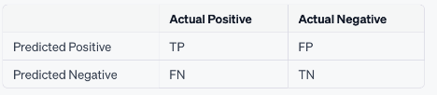
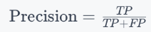
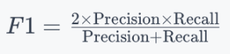
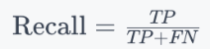
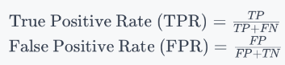
Evaluation: Evaluation Metrics for Classification
Confusion Matrix: A table that is often used to describe the performance of a classification model
F1-Score: Harmonic mean of Precision and Recall.
ROC Curve and AUC (Area Under the Curve)
ROC Curve: Plots the True Positive Rate (TPR, or Recall) against the False Positive Rate (FPR) at various threshold settings.
AUC: The higher the AUC, the better the classifier is at making distinctions between positive and negative cases.
Resources: https://www.youtube.com/watch?v=4jRBRDbJemM&t=956s
Precision-Recall curve: Plots the Precision (positive predictive value) against Recall (sensitivity).
Notes:
The Receiver Operating Characteristic (ROC) curve is a graphical representation of the performance of a binary classifier as its discrimination threshold changes.
An AUC of 0.5 indicates no discrimination (equivalent to random guessing), and an AUC of 1.0 indicates perfect discrimination.

Slide 18
Evaluation
Sample Code:
My GitHub, Lab07, Evaluation.ipynb

Slide 19
Break
Linear Programming – Transportation
break (10 mins)
Set Up your Jupyter We will do some coding to build two decision tree models and evaluate them
Please download Lab07 and 2 csv files from my github

Slide 20
Questions?

